Slide 1
전주예수병원
USM_LGM Serial Number

Slide 2
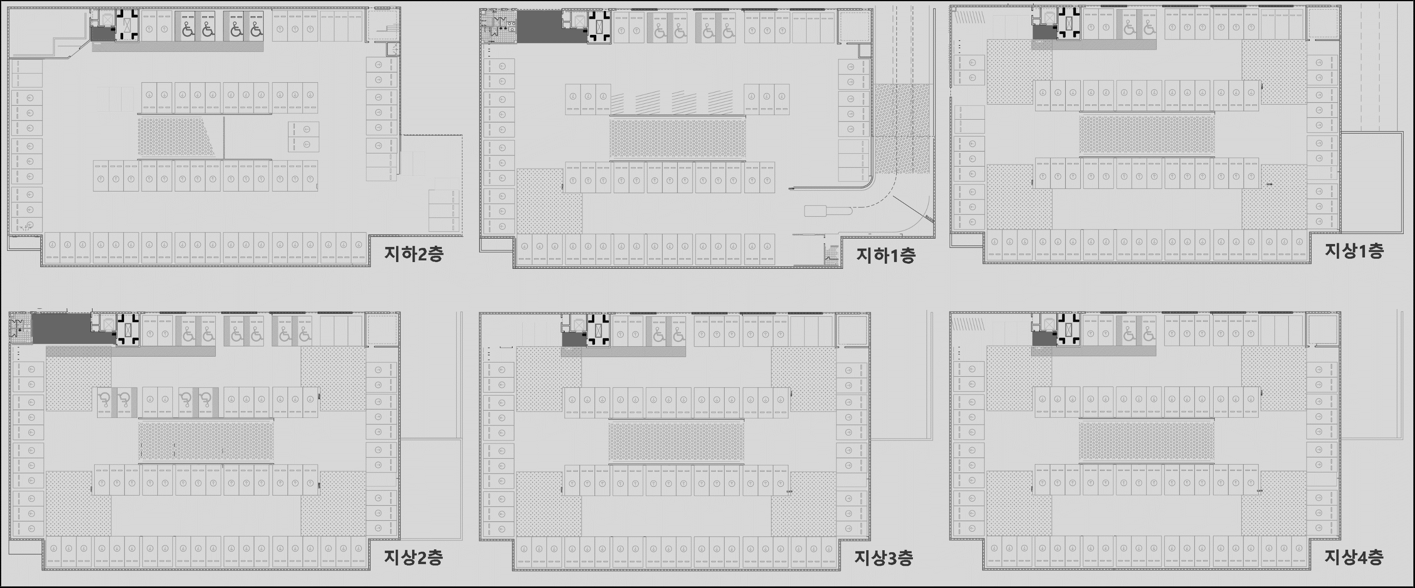
SCM1
SCM3
SCM4
SCM2
SCM5
SCM6
SCM8
SCM10
SCM7
SCM9
SCM11
SCM 1~11
USM 4831~5319
LGM 1671~1849

Slide 3
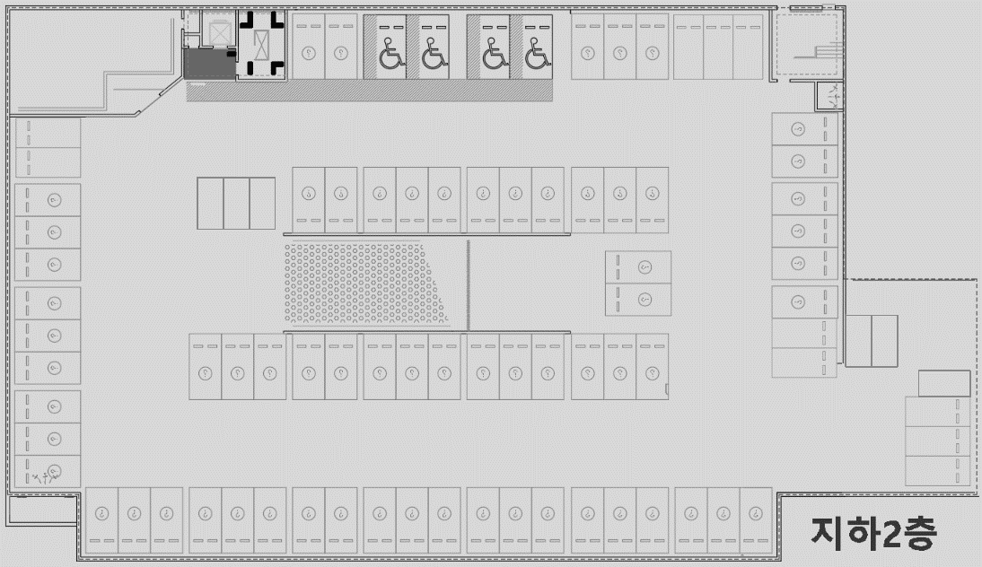
4854
4851
4848
4845
1679
1678
1677
1676
1675
4887
1691
1680
1681
1682
1683
1684
1674
4843
4889
4860
4863
4866
4869
4857
1692
1673
4871
4840
4892
4872
1685
1693
1672
4886
4884
4882
4879
4876
4873
4837
1849
4834
4895
1690
1689
1688
1687
1686
1694
1671
1695
1696
1697
1698
1699
1700
1701
4831
4898
4901
4904
4906
4909
4912
4915
4917
SCM1(42,15)
4831~4872
1671, 1849, 1672~1685
SCM2(45,16)
4873~4917
1686~1701

Slide 4
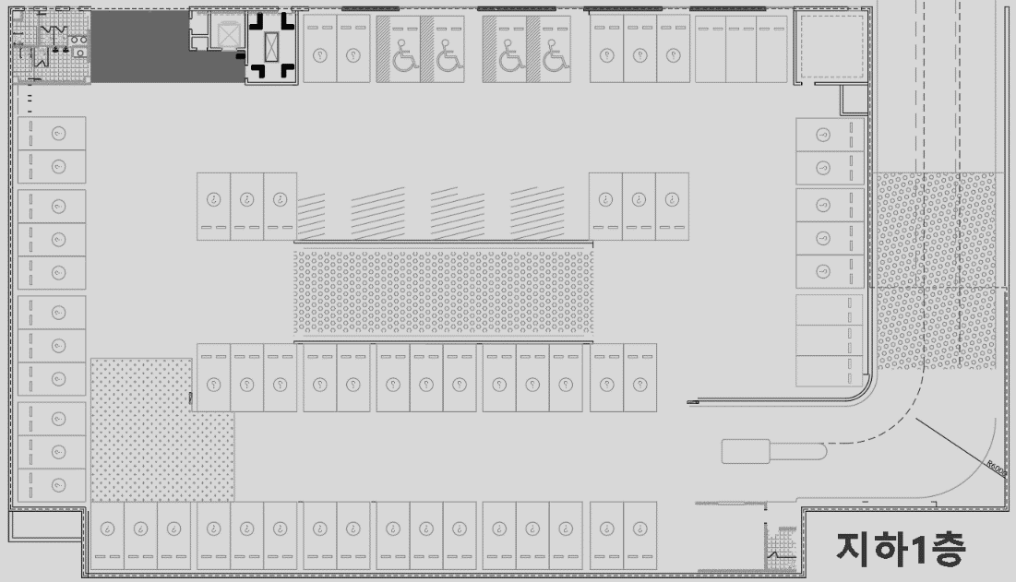
4936
4934
4932
4929
4926
1709
1708
1707
1706
1705
4957
1717
1710
1711
1704
4924
4959
4938
4940
4941
4943
1718
1703
4921
4962
1719
1702
4956
4954
4952
4949
4946
4944
4918
4965
1716
1715
1714
1713
1712
1720
1721
1722
1723
1724
1725
1726
4968
4971
4974
4976
4979
4982
4983
SCM3(66,25)
4918~4983
1702~1726

Slide 5
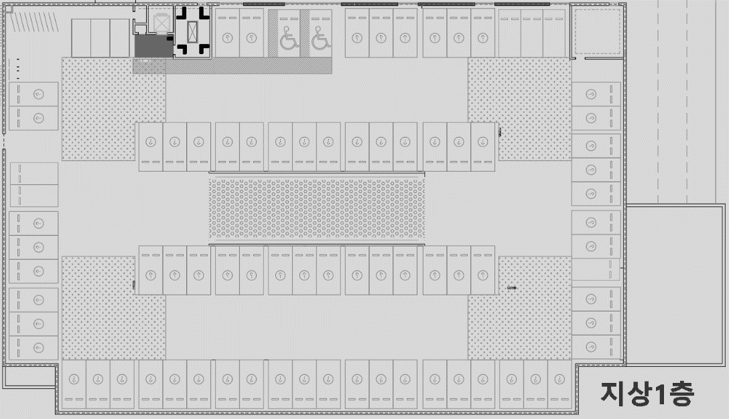
5006
5004
5001
4998
4995
5010
5008
1736
1735
1734
1733
1732
1731
5039
1747
1737
1738
1739
1740
1741
1730
4993
5011
5014
5016
5019
5022
5024
5041
1729
1748
4990
5043
1749
1728
5038
5036
5034
5031
5028
5025
4987
5046
1746
1745
1744
1743
1742
1750
1727
1751
1752
1753
1754
1755
1756
1757
4984
5049
5052
5055
5057
5060
5063
5066
5068
SCM4(41,15)
4984~5024
1727~1741
SCM5(44,16)
5025~5068
1742~1757

Slide 6
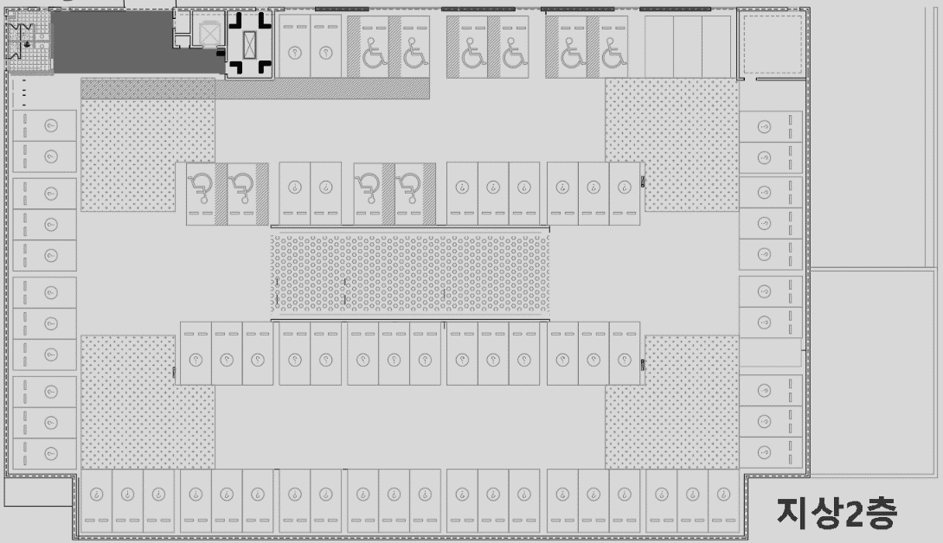
5089
5090
5087
5085
5083
5080
1766
1765
1764
1763
1762
5117
1776
1767
1768
1769
1770
5078
1761
5119
5091
5093
5095
5097
5100
5102
1777
1760
5075
5122
1778
1759
5116
5114
5112
5109
5106
5103
5072
5125
1773
1772
1775
1774
1771
1779
1758
1780
1781
1782
1783
1784
1785
1786
5069
5128
5131
5134
5136
5139
5142
5145
5147
SCM6(34,13)
5069~5102
1758~1770
SCM7(45,16)
5103~5147
1771~1786

Slide 7
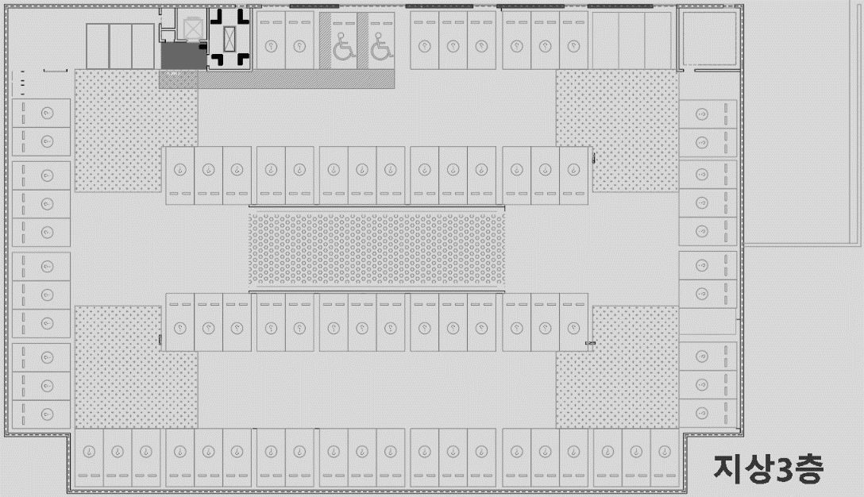
5170
5168
5165
5162
5159
5174
5172
1796
1795
1794
1793
1792
1791
5203
1807
1797
1798
1799
1800
1801
1790
5157
5205
5175
5178
5180
5183
5186
5188
1808
1789
5154
5208
1809
1788
5202
5200
5198
5195
5192
5189
5151
5211
1806
1805
1804
1803
1802
1810
1787
1811
1812
1813
1814
1815
1816
1817
5148
5214
5217
5220
5222
5225
5228
5231
5233
SCM8(41,15)
5148~5188
1787~1801
SCM9(45,16)
5189~5233
1802~1817
1787

Slide 8
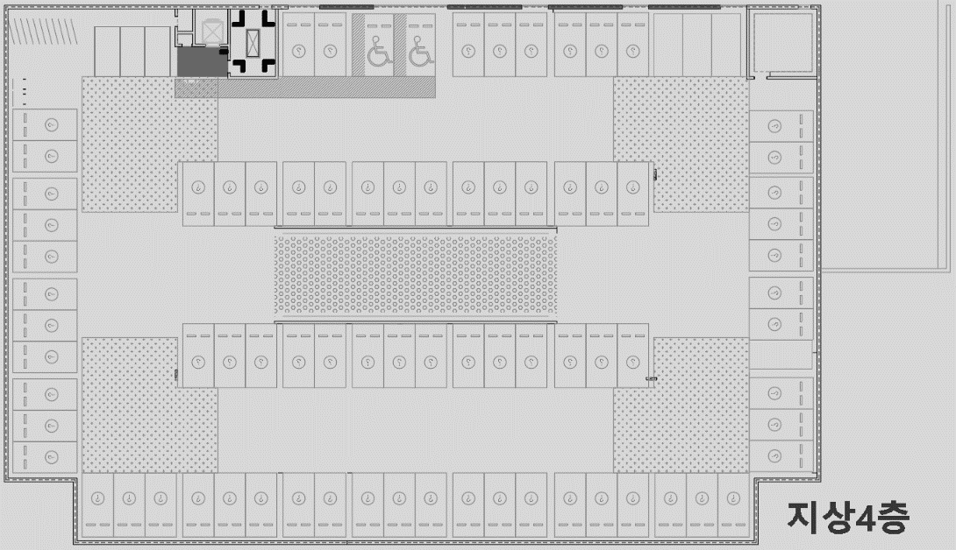
5256
5254
5251
5248
5245
5260
5258
1827
1826
1825
1824
1823
1822
5289
1838
1828
1829
1830
1831
1832
1821
5243
5291
5261
5264
5266
5269
5272
5274
1839
1820
5240
5294
1840
1819
5288
5286
5284
5281
5278
5275
5237
5297
1837
1836
1835
1834
1833
1841
1818
1842
1843
1844
1845
1846
1847
1848
5234
5300
5303
5306
5308
5311
5314
5317
5319
SCM10(41,15)
5234~5274
1818~1832
SCM11(45,16)
5275~5319
1833~1848

